Slide 1

Hot issues october 2020
Karel Abbenes : kaa@ballooning-federation.eu
European Ballooning Federation

Slide 2
Introduction of Part BOP – Balloon Operations
Introduction of Part BFCL – Balloon Flight Crew Licensing
Integration with Drones // Electronic Conspicuity// U Space
Implementation Part M light
Green deal
Medical
Covid 19 and Return to Normal Operations

Slide 3
Quick overview:
Introduction of Part BOP Balloon Operations and Part BFCL Balloon Flight Crew Licensing.
Issue remaining is OPC with FE to be discussed
Are there things EBF needs to do to help?

Slide 4
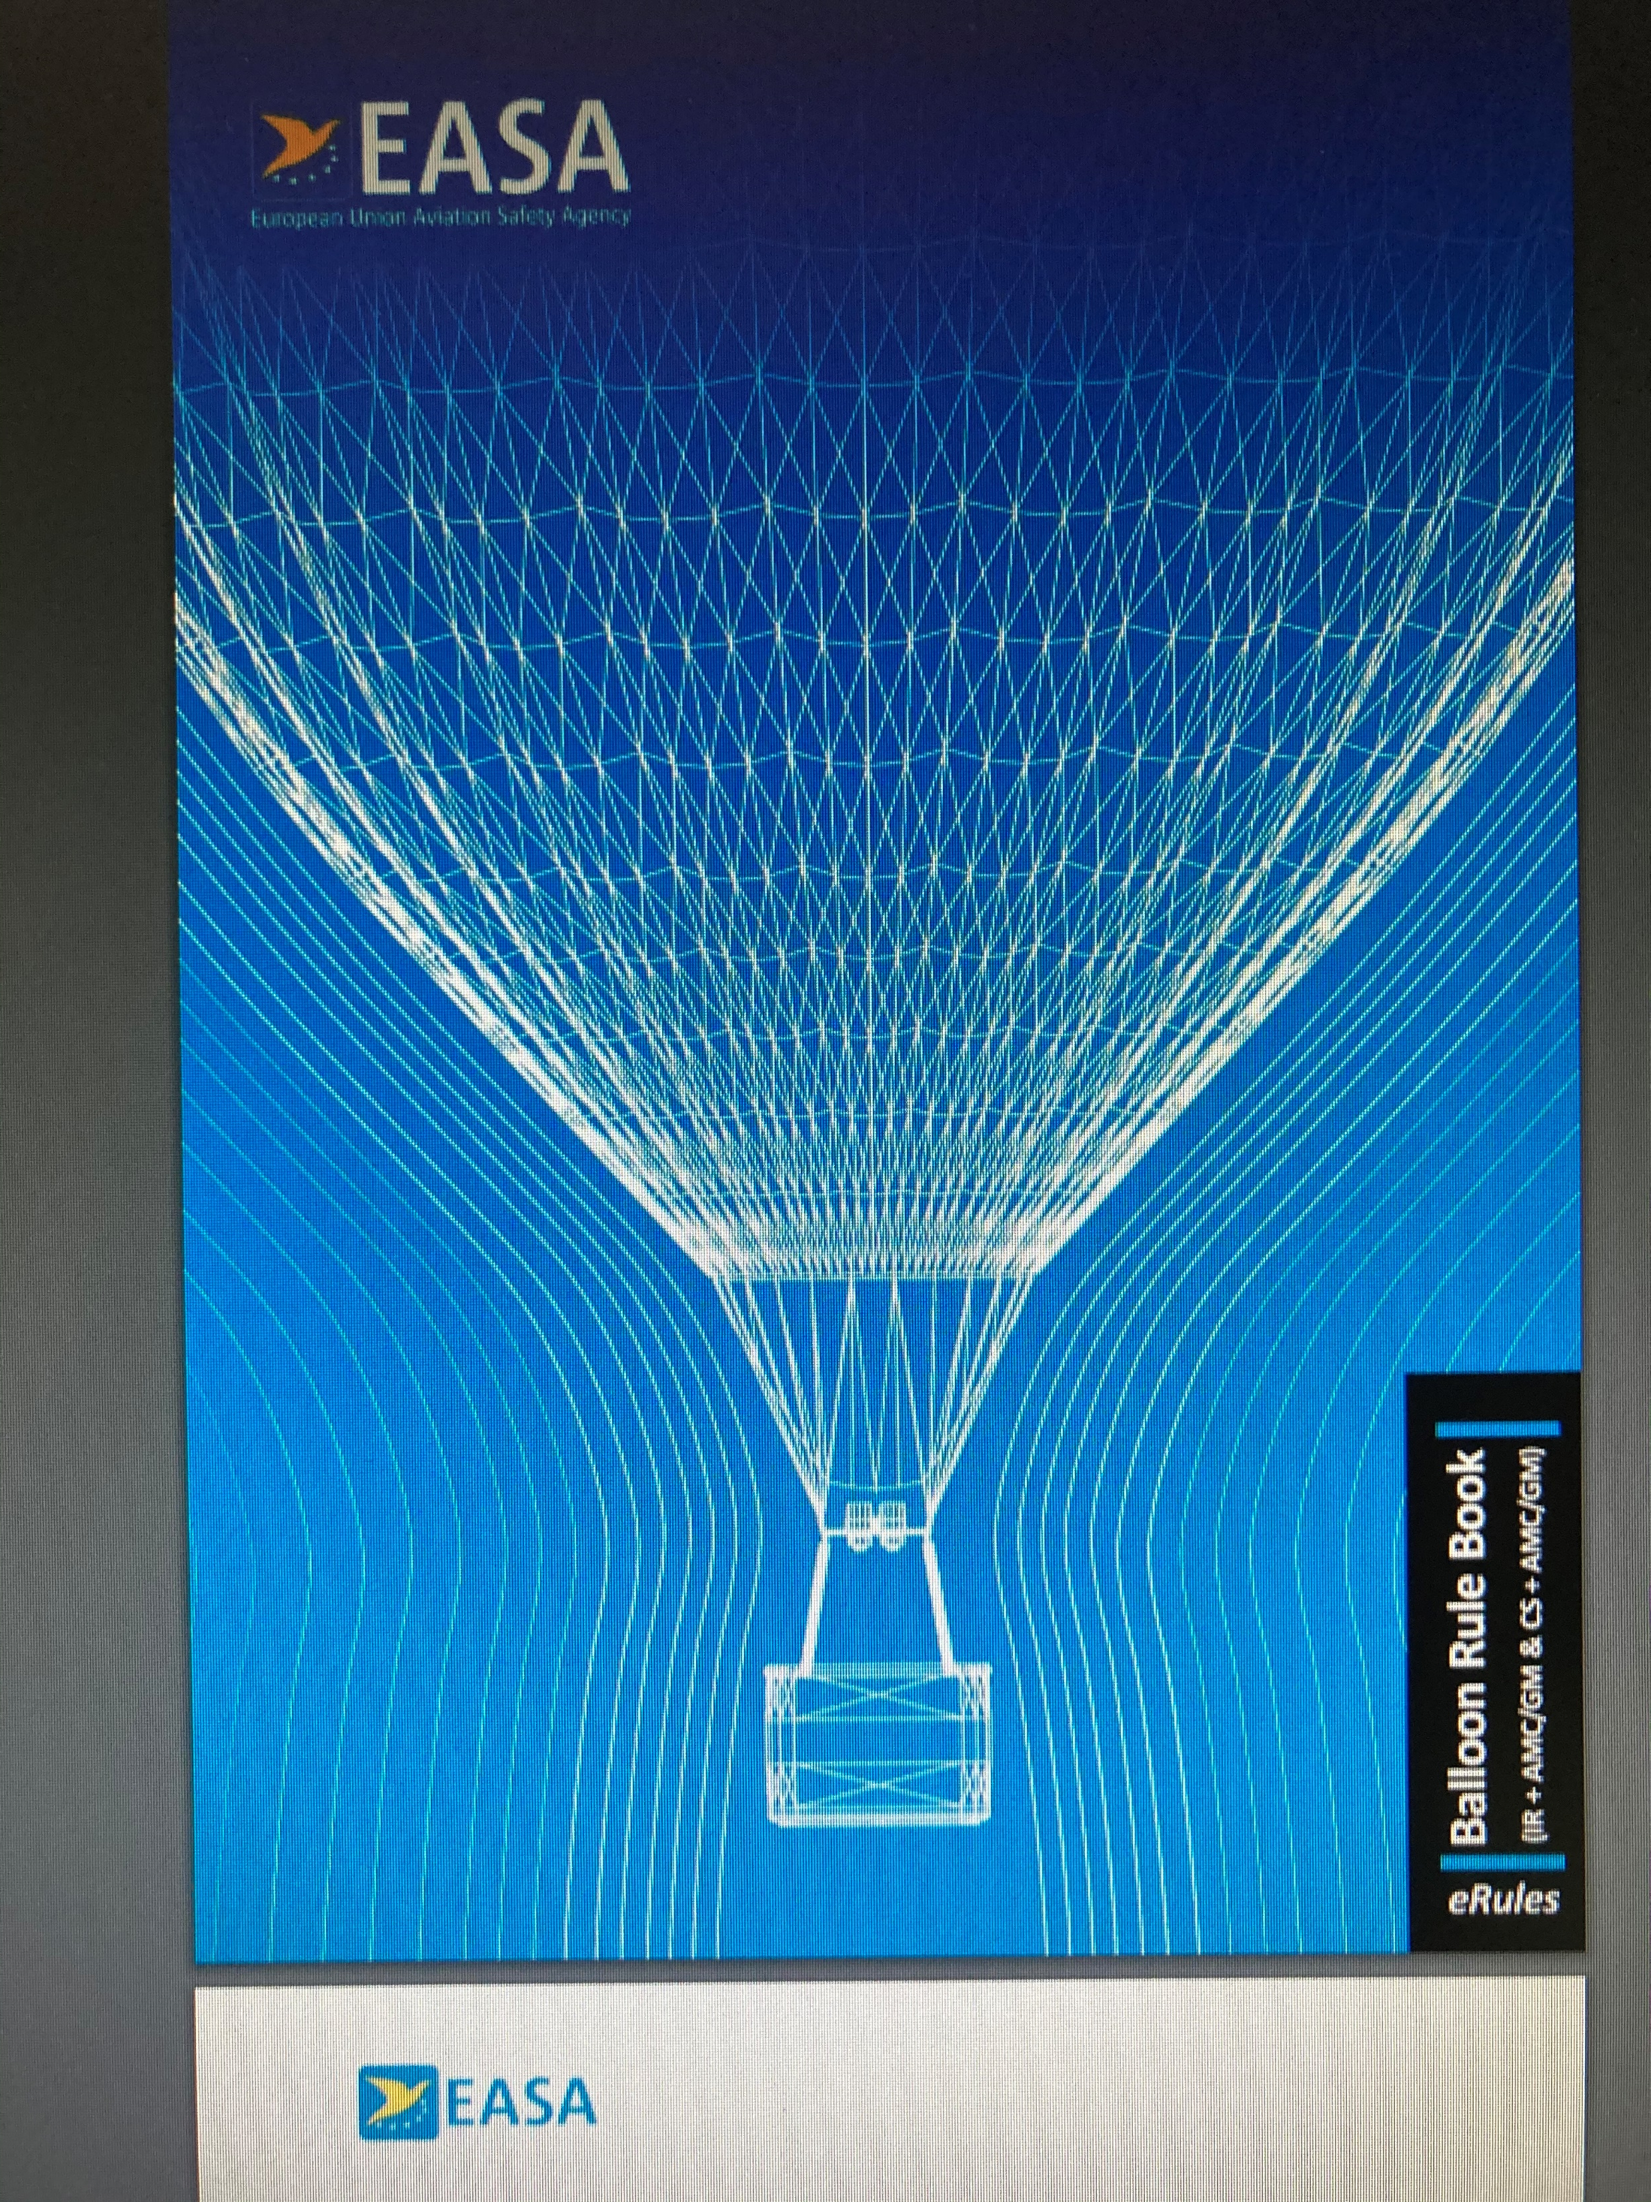
EASY ACCES RULES FOR BALLOONS PUBLISHED:
https://www.easa.europa.eu/sites/default/files/dfu/Balloon%20Rule%20Book.pdf

Slide 5
Quick overview:
Integration of Drones in the airspace and Electronic conspicuity
Worries about the power and finance behind drones could be detrimental to GA,
Cost involved to be detected by drones VV,
Priorities manned over unmanned not yet clear.
Some countries have large TSA’s to accommodate drones whilst limiting GA.

Slide 6
Quick overview:
Introduction of Part M light
Experts need to make differences clear for private operators
Who can do that?

Slide 7
Quick overview:
The green deal is going to effect all of us.
How this will affect us is unclear,
We need to make sure we communicate our willingness to become even more green and environmental friendly

Slide 8
Quick overview:
Easier acces to medical certificate is being discussed and promoted. Self declaration for private pilots, easier access tot medical class 2

Slide 9
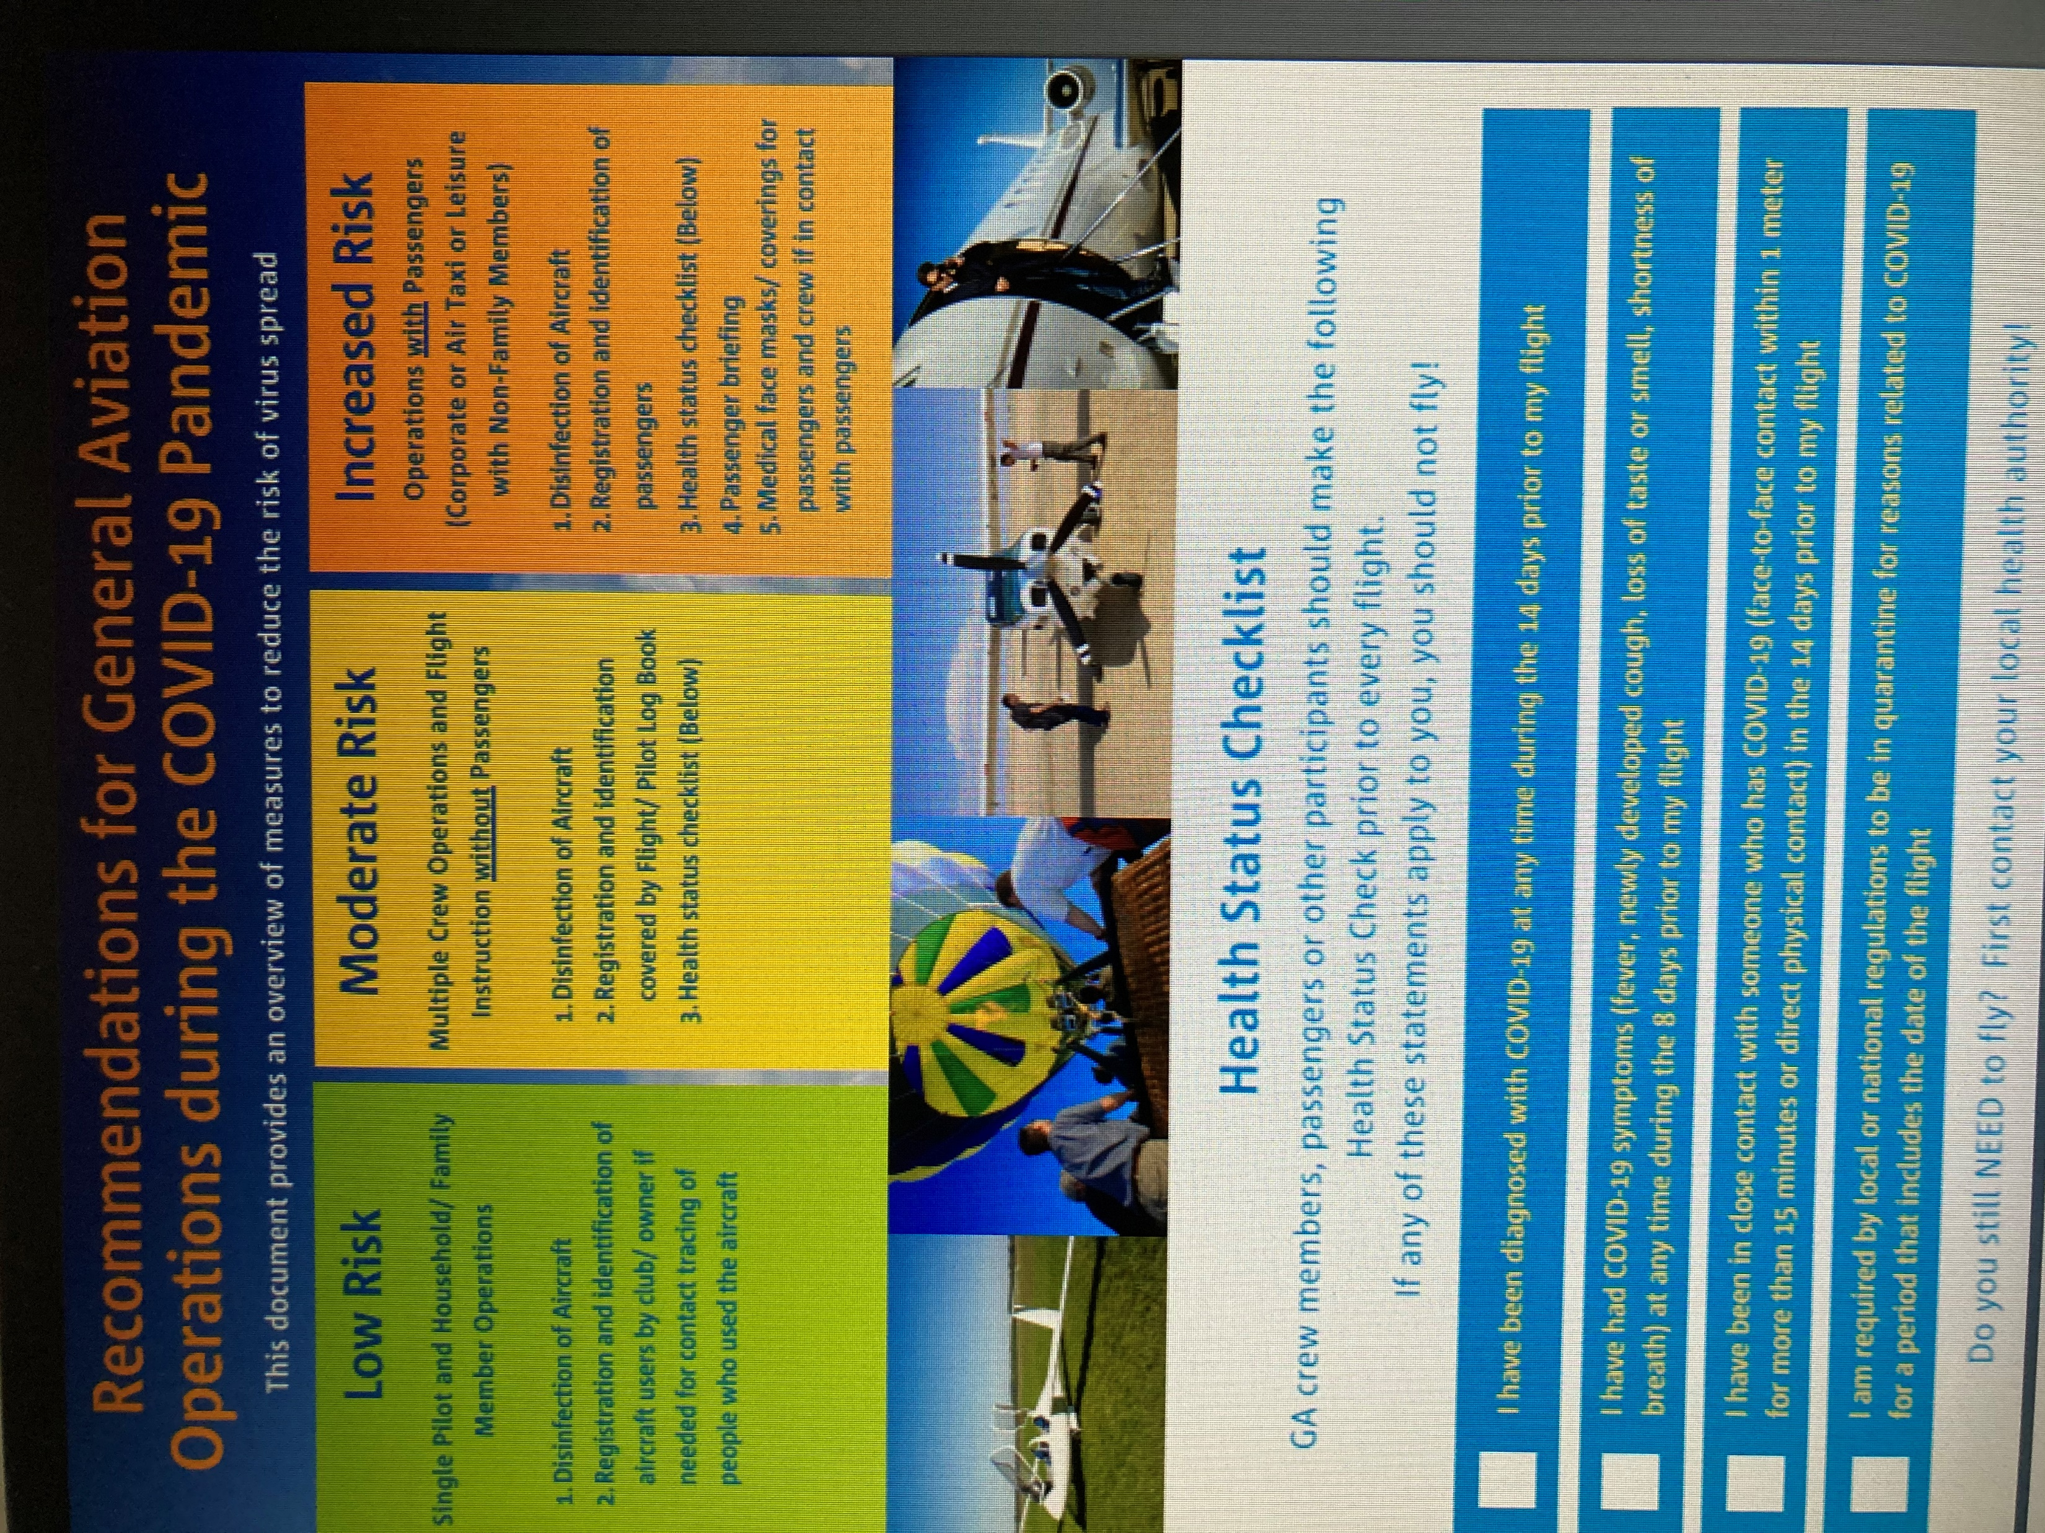
Quick overview:
Return to Normal Operations
EASA initiative to co-ordinate measures taken by NAA’s re GA
Big difference per Country in limiting measures for GA taken and length of measures. Some countries no/hardly limitation on GA some not returned to normal as yet.
Poster Published: https://www.easa.europa.eu/sites/default/files/dfu/ga_operations_during_covid-19.pdf
Report with measures to be taken published. Continuing process. Input wanted!

Slide 10
EBF needs input in order to be the European representative for all Balloonists in Europe!!

